Slide 1
Secure Data Hiding in Image Using Steganography
Student Name : Parth Balasaheb Bhegade
College Name & Department : P.E.S Modern College Of Engineering , Artificial Intelligence and Machine Learning

Slide 2
OUTLINE
Problem Statement
Technology used
Wow factor
End users
Result
Conclusion
Git-hub Link
Future scope

Slide 3
Problem Statement
In the modern digital world, secure data transmission is crucial. Traditional encryption methods are often detectable, making sensitive messages prone to interception. This project leverages image steganography to embed hidden messages within images, providing an undetectable and secure method for confidential communication.

Slide 4
Technology used
Programming Language: Python
Libraries: OpenCV, NumPy
Platform: Google Colab (for execution)

Slide 5
Wow factors
🔹 Stealth Communication – The message is embedded without altering the image's appearance.
🔹 Password-Protected Encryption – Ensures that only authorized users can extract the message.
🔹 Lightweight & Fast – Efficient data hiding without external dependencies.
🔹 User-Friendly – Simple execution with minimal technical expertise required.

Slide 6
End users
👨‍💻 Cybersecurity Experts – Securely transmit sensitive data.
🕵️‍♂️ Journalists & Activists – Protect confidential communications.
🏛 Government & Defense Agencies – Enhance secure intelligence sharing.
🔐 Everyday Users – Keep personal messages hidden from unauthorized access.

Slide 7
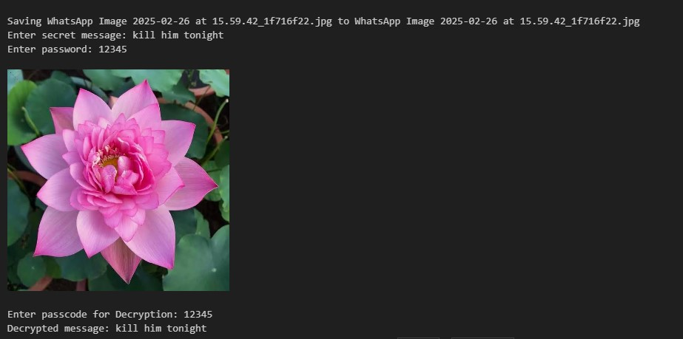
Results

Slide 8
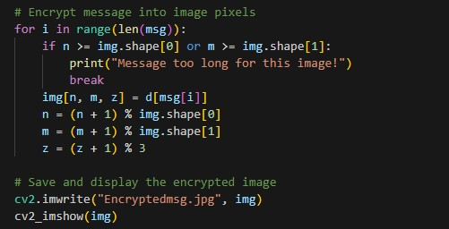
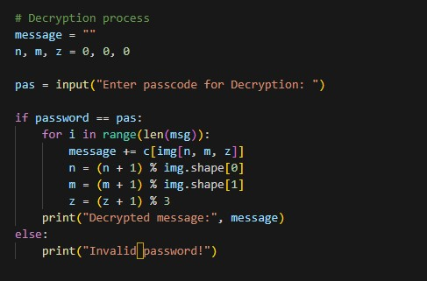

Slide 9
Conclusion
This project provides an efficient, secure, and undetectable method for covert communication. By embedding text into images, it enhances confidentiality while maintaining a seamless user experience.

Slide 10
GitHub Link
https://github.com/Parth26022004/Secure-data-hiding-with-image.git

Slide 11
Future scope(optional)
🚀 Enhanced Security – Integrate AES or RSA encryption for an added layer of protection.
📱 Web & Mobile App – Build an intuitive UI for broader accessibility.
🔍 AI-Powered Steganography – Use deep learning to improve detection resistance.
🔢 Multi-Format Support – Extend functionality to video and audio steganography.

Slide 12
THANK YOU

